Slide 1
Heat Transfer Report after Eval_1
Determination of fin - shape with highest efficiency

Slide 2
TABLE OF CONTENTS
01
05
02
06
03
07
04
08
09
06
Process Explanation
And Equations
About the Project
CAD Models
Data Analysis
Types of Fins
Validation of data
Initial Setup
Simulation
Acknowledgement

Slide 3
01
About the project

Slide 4
About the project
The objective of our project is to determine the optimal shape of fins that would yield the highest efficiency in heat transfer. We aim to analyze temperature profiles and identify the most efficient shape among three variations: cylindrical pin fin, tapered profile pin fin, and concave parabolic pin fin, Variable area straight fin. The aim of this project is to find a balance between convection heat transfer coefficient and surface area, considering the practical constraints associated with fluid motion and the potential drawbacks of excessive fin density.

Slide 5
02
CAD Models

Slide 6
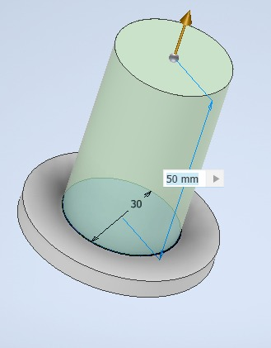
CYLINDRICAL FIN

Slide 7
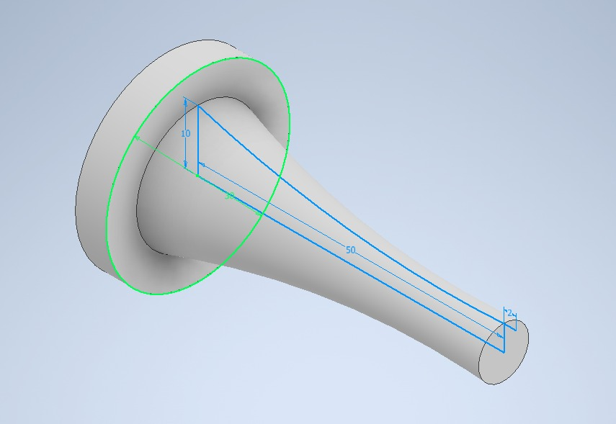
CONCAVE FIN

Slide 8
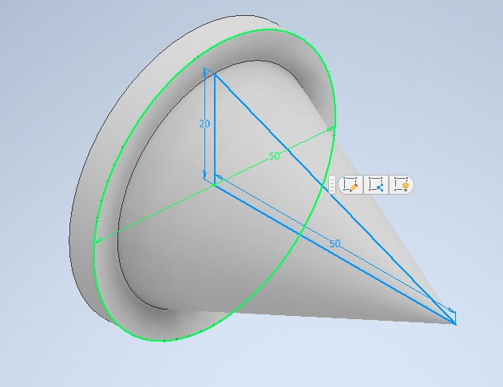
CONICAL FIN

Slide 9
03
Types of fins

Slide 10
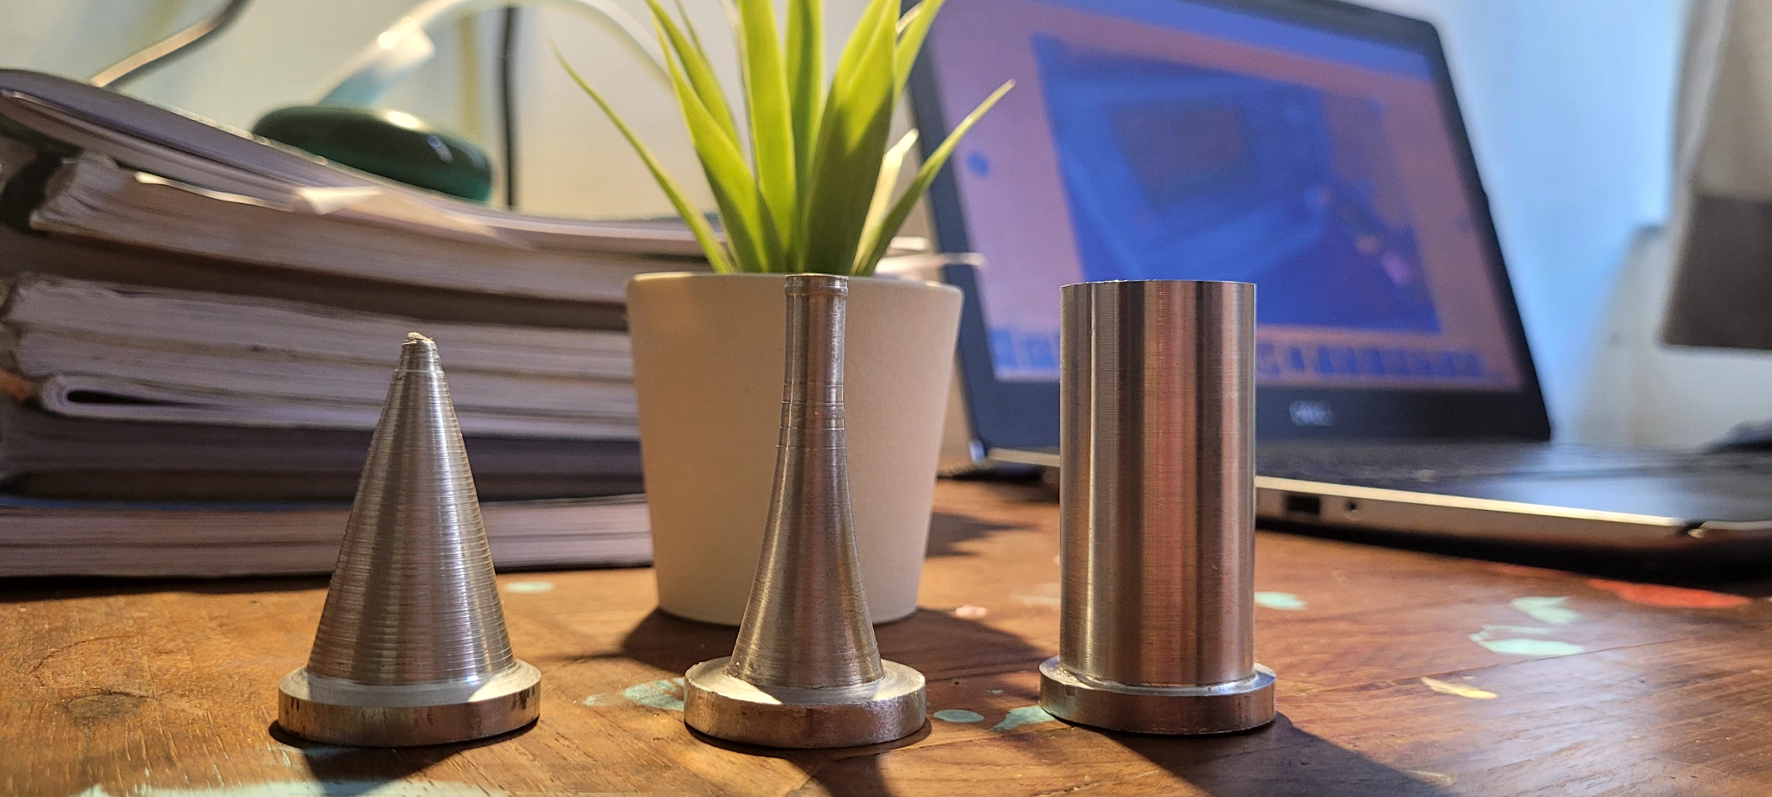
TYPES OF FINS
Material used for the fin: Aluminium
Cylindrical Fin
Concave Pin Fin
Conical Pin Fin

Slide 11
04
Initial Setup

Slide 12
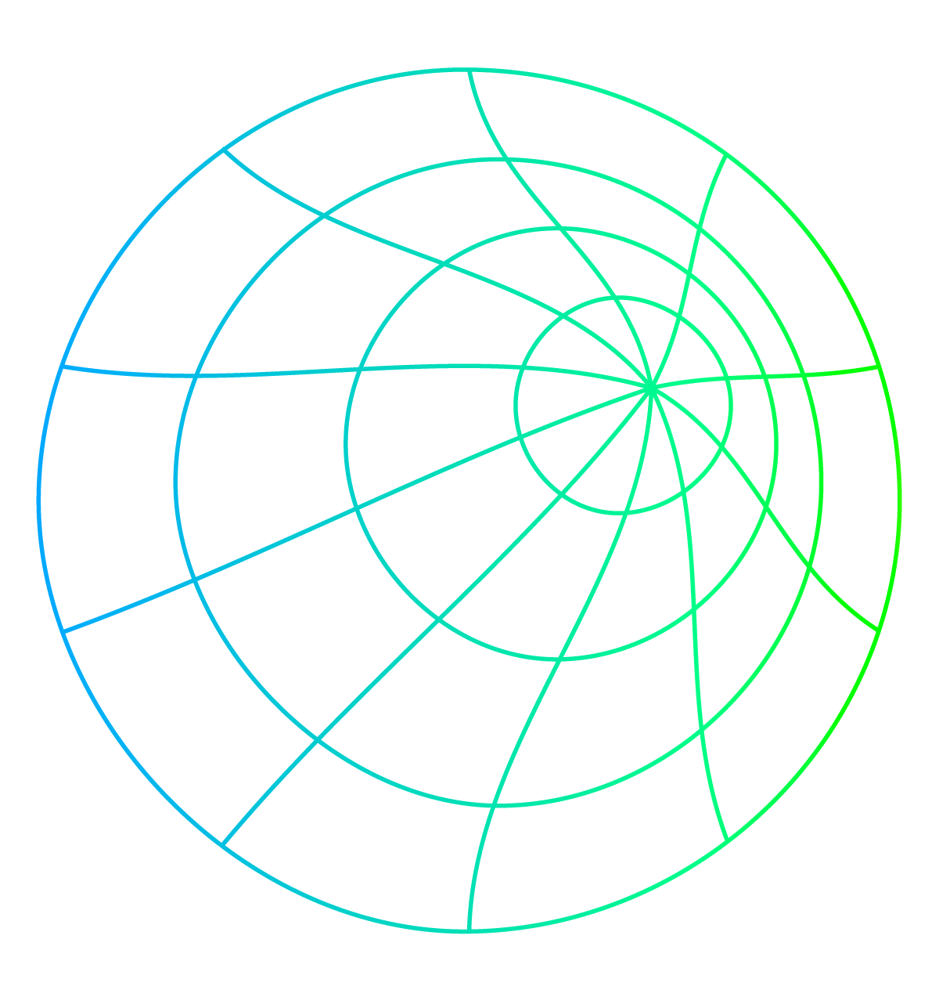
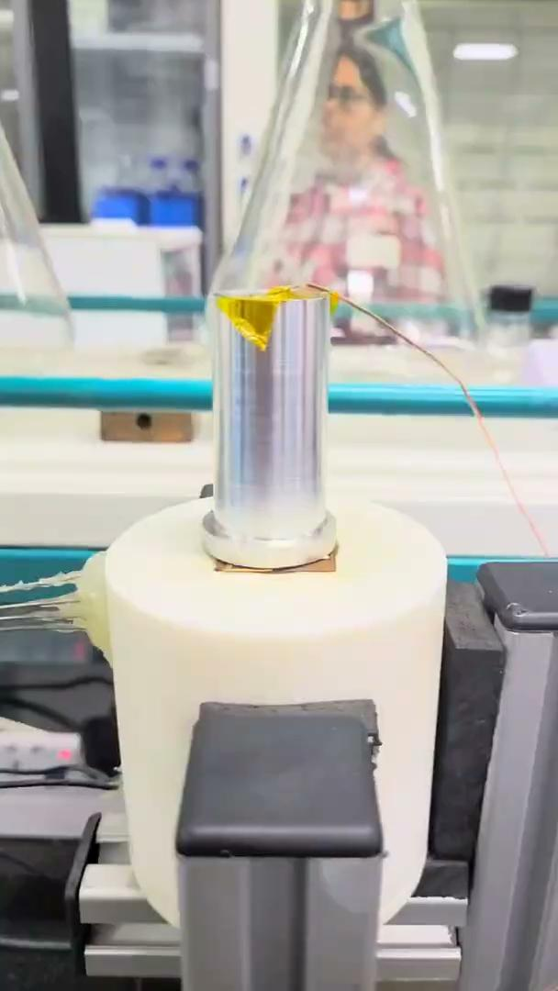

INITIAL SETUP
For Detailed Explanation about the setup scan this :
https://drive.google.com/file/d/1ZPNPWyrJ22aRag_fqXbGgNzLX2Acu_Mq/view?usp=drivesdk

Slide 13
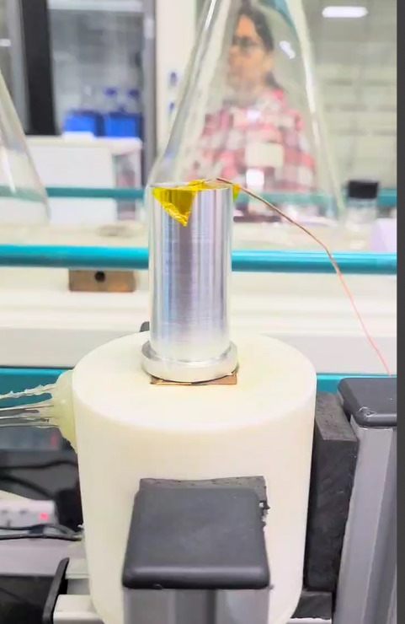
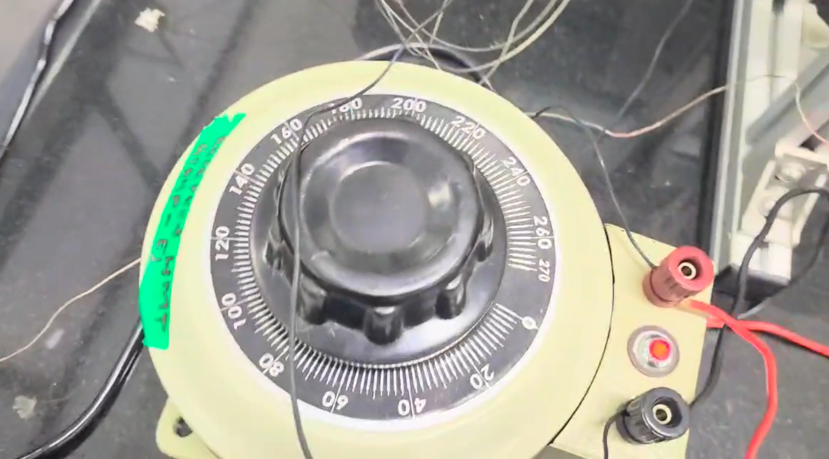
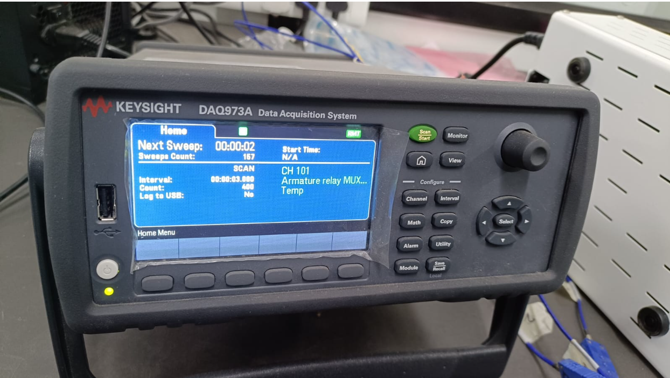
EQUIPMENTS OF EXPERIMENTAL SETUP
Electric Heater
Voltage Controller
Data Acquisition System

Slide 14
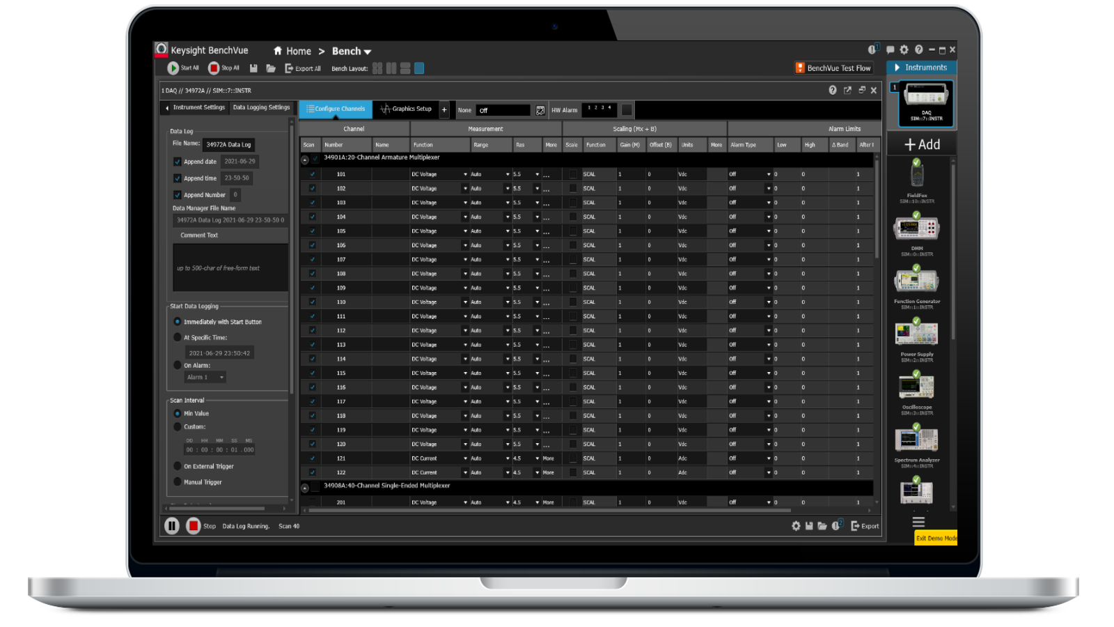
Software Used: Keysight-BenchVue
Keysight Benchvue

Slide 15
Process calculations and equations
05

Slide 16
Process Explanation
We place the object with its extruded surface on the heater. We have made the base of the object with 30mm diameter so that it could fit properly on the heater.We then use the polyimide tape to stick the K type thermocouple on the tip or the starting part of the fin. Then, we set the voltage to 80V and fix the duration of 20 minutes. In the BenchVue Keysight software, we have the 3 second time interval of temperature recording and recorded 400 scans of each fin. We have also recorded the temperature of the heater at 3 points at distance of 0.5mm each.
We will be plotting the graph of each fin with all the four temperatures i.e. the surface temperature and the heater temperatures. Then, we will be doing a comparative analysis of all the graphs to see the maximum temperature loss from the surface.
.

Slide 17
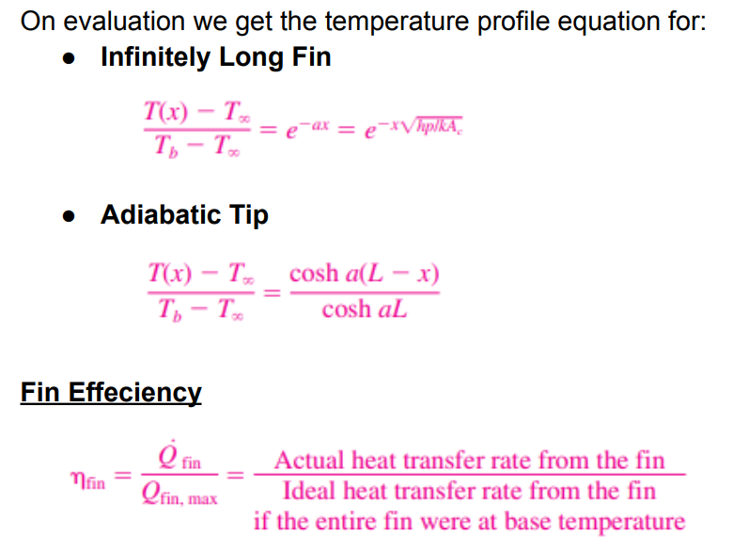
Equations
.

Slide 18
06
Data Analysis

Slide 19
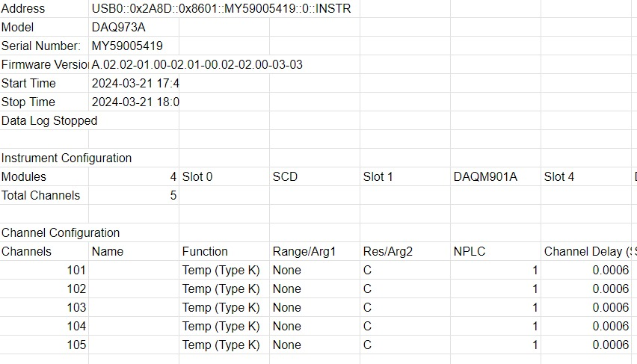
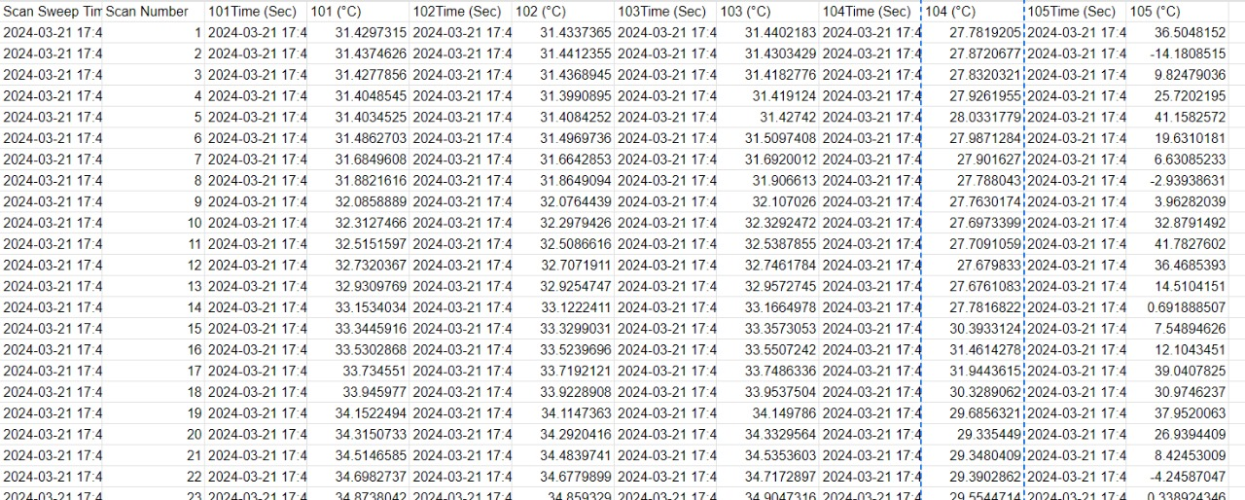
Raw Data
.

Slide 20
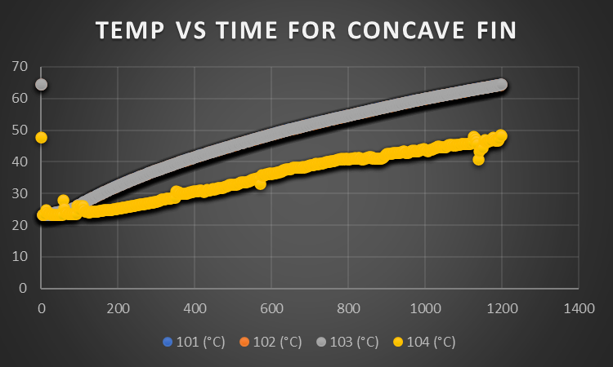
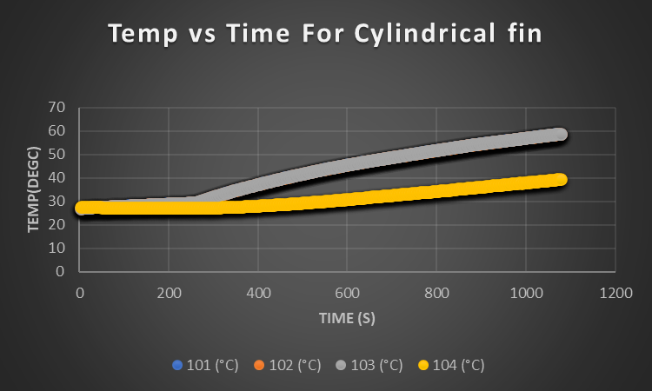
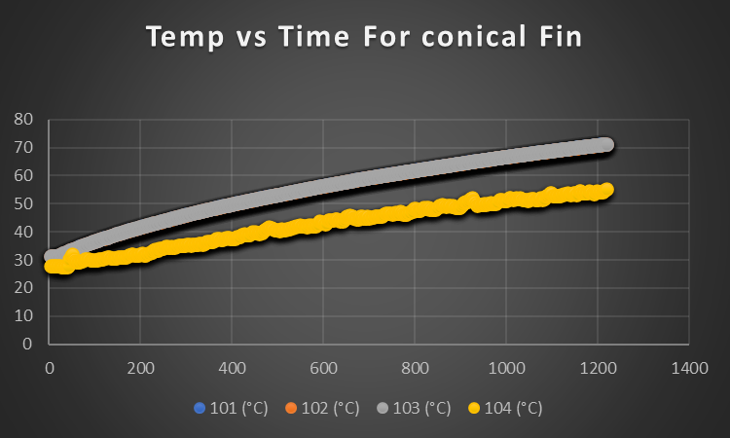
TEMP VS TIME PLOTS FOR ALL FINS

Slide 21
Tasks completed After Eval - 2

Slide 22
07
Validation of data

Slide 23
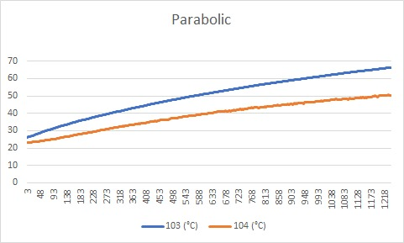
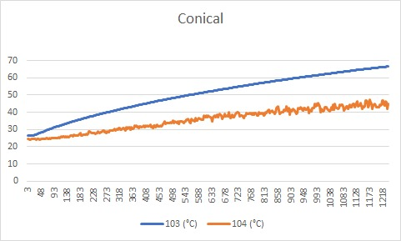
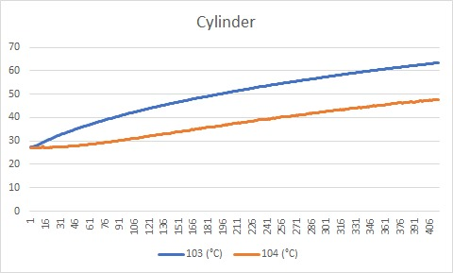
TEMP VS TIME PLOTS FOR ALL FINS (Done Again)

Slide 24
08
Simulations

Slide 25
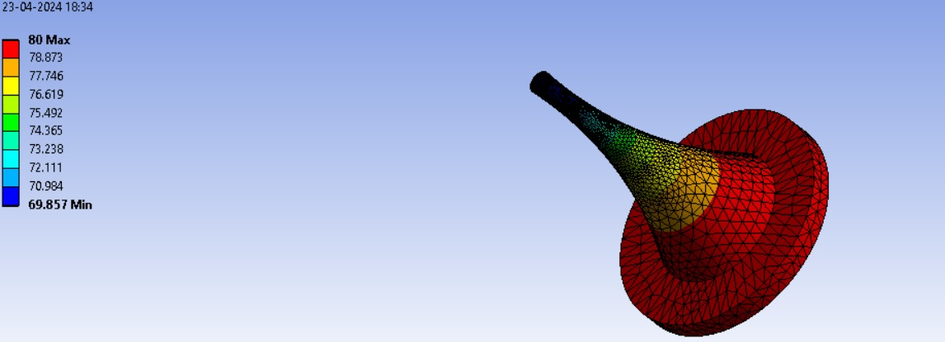
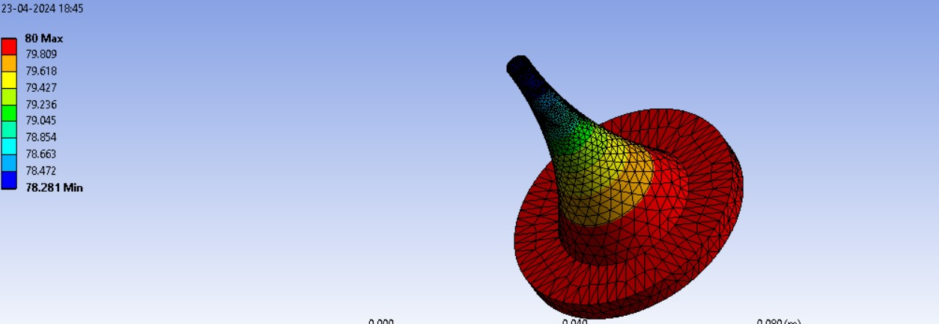
Simulations: Concave fin
50 mm
40 mm

Slide 26
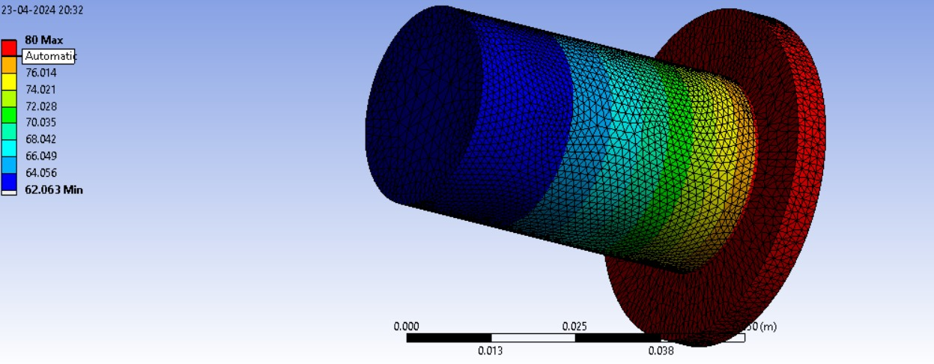
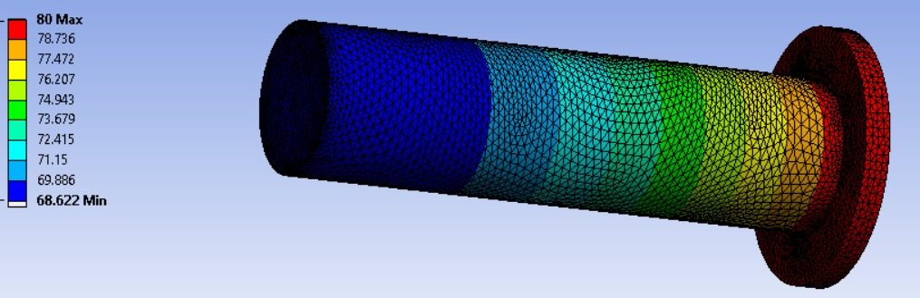
Simulations: Cylindrical fin
50 mm
60 mm

Slide 27
Efficiency
Real Experiments Ideal
Concave fin : Concave fin:
With Length 50 mm : 70% With Length 50 mm : 82.5%
With Length 40 mm : 97%
Cylindrical fin : Cylindrical fin :
With Length 50 mm : 45% With Length 50 mm : 69%
With Length 60 mm : 80.3%
Conical fin: Conical fin:
With Height 50 mm : 68.75% Could not do due to error

Slide 28
Acknowledgements
We would like to thank Prof.Soumyadip Sett and Prof.Biswajit Saha for their guidance.We would like to thank the machine shop IITGN for their essential help. We would also like to thank the Teaching Assistants for their guidance and support.

Slide 29
OUR TEAM
Atharva Bodhale
Shivrajsinh
Bhosale
Purva
Shah
22110043
22110048
22110207
Shrey
Agarwal
Vedant
Chichmalkar
22110244
22110282

